Slide 1
Block II

Slide 2
Ecological networks – an example
Habitat destruction
Remnant habitat patches are left in the landscape
They can still support biodiversity, but they benefit from being ecological connected with other patches

Slide 3
Graph/network approach
R
R=Movement ability (m)

Slide 4
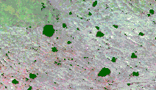
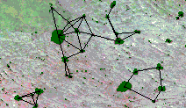
An example

Slide 5
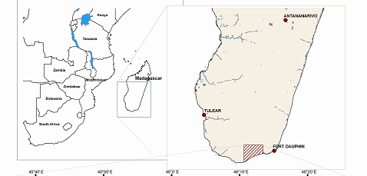
Study area: Androy, southern Madagascar
The value of small size: loss of forest patches and threshold
effects on ecosystem services in southern Madagascar
Bodin et al, Ecological Applications 16(2)

Slide 6
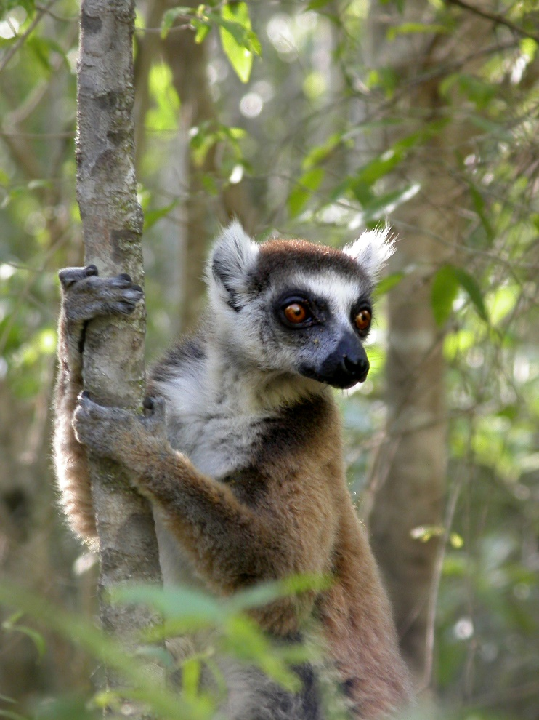
Seed dispersal by Lemur catta
  Lives in the forest patches, but can traverse the matrix
  Are the sole disperser for many plant species

Slide 7
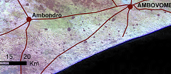
Agricultural landscape
Many small distinct (sacred) forest patches scattered in the landscape (<1 to 95 ha)

Slide 8
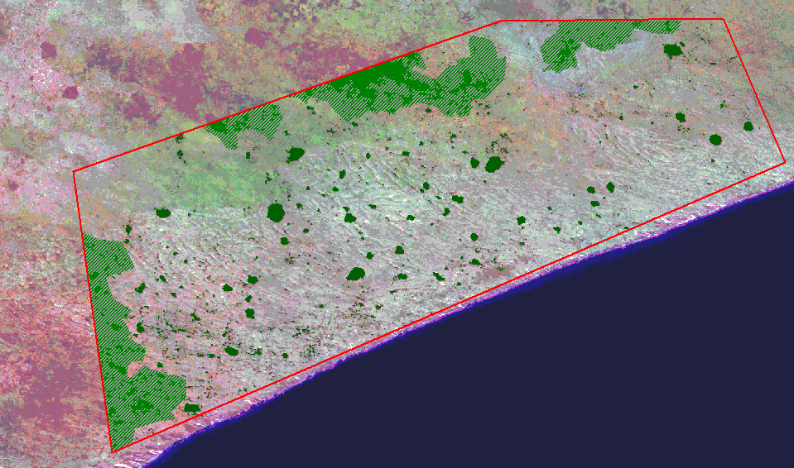
Landsat image – southern Madagascar

Slide 9
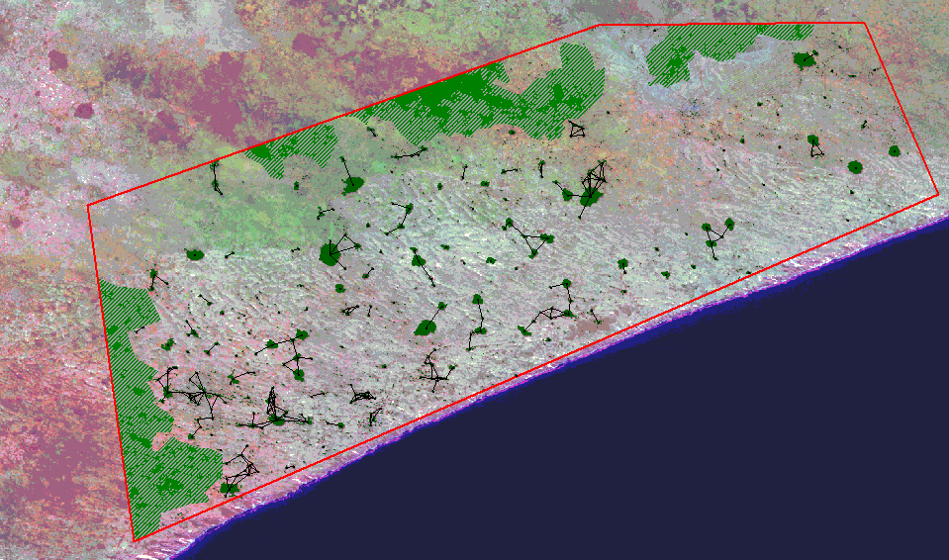
Maximum movement = 500m

Slide 10
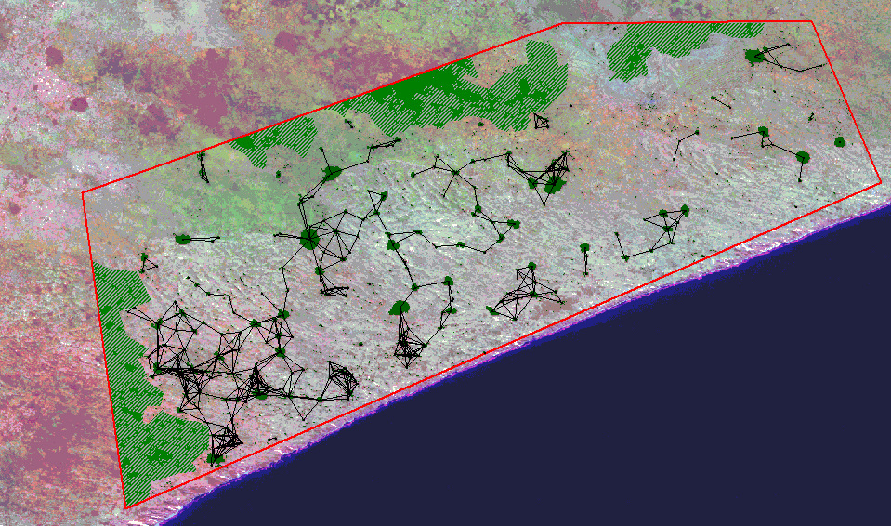
Maximum movement = 1000m (~Lemur catta)

Slide 11
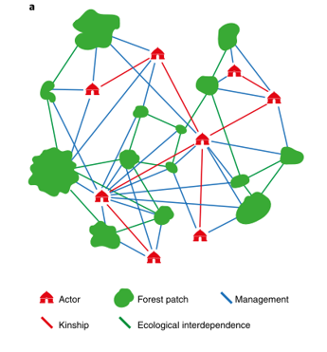
But governing fragmented landscapes involve more than just preserving habitat patches…
Bodin Ö, Alexander SM, Baggio J, et al (2019) Improving network approaches to the study of complex social–ecological interdependencies. Nature Sustainability 2:551–559.

Slide 12
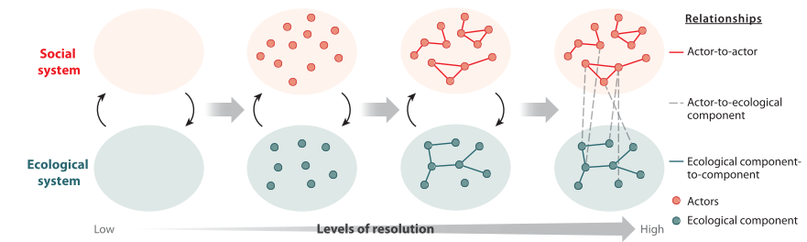
A multilevel network model that makes interdisciplinary analyses possible
Bodin et al. 2020, Annual Review of
Environment and Resources

Slide 13
Why social-ecological networks?
Environmental problems are just as much social-ecological problems
The environment is a “networked” ecosystem
…and the social “system” consists of many actors/institutions/etc.
=> No single actor in charge, nor able to deal with all ecosystem components him/herself

Slide 14
What is a “useful” network representation of a social-ecological system?
1. Start with the human/nature interaction of interest (extracting fish, enjoying scenery)
2. What might be influencing the “actors” determining how they will interact with nature (fish more, change gear, go somewhere else)
  Social influence among peers, negotiating agreement on regulating extraction..
3. What kind of ecological interdependencies are relevant given the type of human/nature interaction?
  If fishing, food web dynamics, fish migration, …
4. “Scale matching”, all nodes and links should be able to significantly affect each other
  Can a single fishermen alter the state of a local fish population, or is a entire fishing fleet only able to do so?

Slide 15
Fishery example
Interaction: small scale fishing in coastal region
Social entity (actor): Perhaps groups of fishermen using the same gear type?
Social interaction of relevance for what fishers do: sharing knowledge related to fishing, where to fish, what to fish, what not to fish…
  Alexander SM, Staniczenko PPA, Bodin Ö (2020) Social ties explain catch portfolios of small‐scale fishers in the Caribbean. Fish & Fisheries 21:120–131.
Ecological interactions: food web interactions, who eat whom?

Slide 16
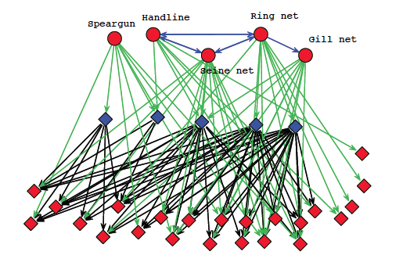
Kenyan small scale fishery
Bodin et al (2014). Conservation Success as a Function of Good Alignment of Social and Ecological Structures and Processes. Conservation Biology

Slide 17
Exercise – build your own social-ecological network
Follow steps 1-4 (often several iterations are needed)
Work in groups of 3-4
Choose a “model system”
This is an exercise, thus use your own assumptions (guesses) about the model system (no need to know all the facts about the model system)
You NEED to simply the system, modeling is all about reducing complexity (but not too much, and not too little – just enough)
Be ready to quickly present your social-ecological network at the end of the exercise
  Justify your choices of nodes and links

Slide 18
Model systems
Tuna fish is dispersed across the globe, and migrate between different locations. Many countries have fishing fleets going after the Tuna.
Precipitation does now acknowledge human defined borders. Evapotranspiration in one country/region comes down as rainfall in other regions. Land use alteration change evapotranspiration (e.g. clear cutting forests could negatively effect evapotranspiration).
Industrial pollution follows the water streams, and affect downstream water quality.
Green areas in urban settings provide many ecosystem services (recreation, biodiversity, local climate regulation such as cooling, ..). But if ecologically isolated, they might decline over time.

